Slide 1

CSC 335
Puzzle Platformer
Eujin Ko, Lize Chen,
Perry Wang, Suyang Chen

Slide 2
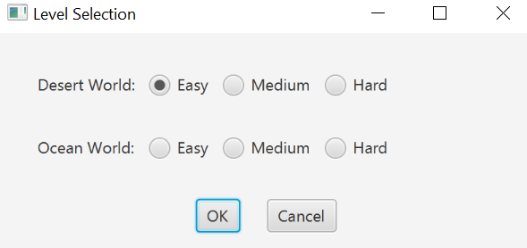
Level Selection

Slide 3
Basic Movement
Go Left: Press “<=”
Go Right: Press “=>”
Jump: Press “space”

Slide 4
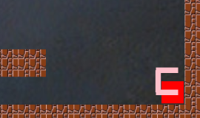
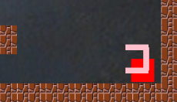
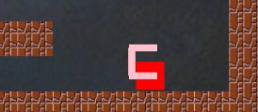
The Player: Blinking Rectangle
When moving the rectangle, it would “blink” for each step.

Slide 5

How To Win
Go to

Slide 6




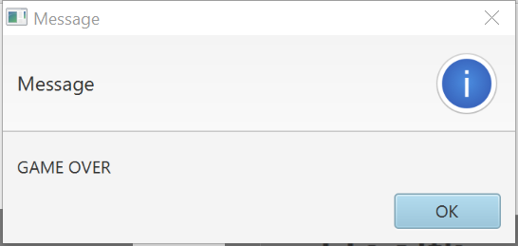
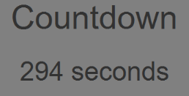
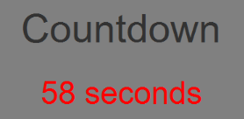
How To Fail
Zero heart
(2) Run out off time

Slide 7
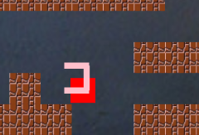
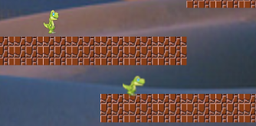
What Affect Health
Fall out of the grid
Touch the monster
(both static and dynamic)
Hearts are decreased by one, and send the player to the start point.

Slide 8
Features
Keys & Doors
Portal
Moving Boxes

Slide 9
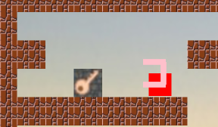
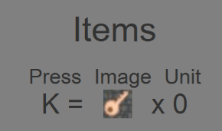
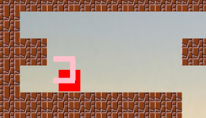
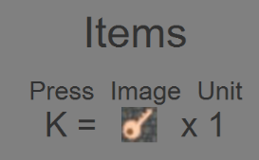
(1) Pick up the keys

Slide 10
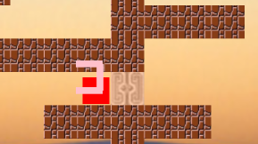
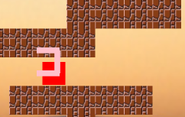
(2) Open the doors
Press “K”

Slide 11
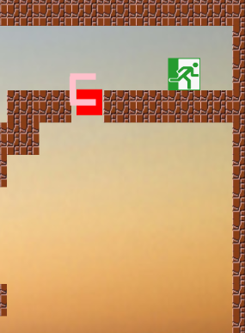
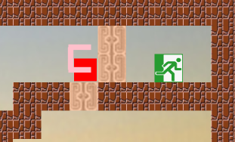
* One key can open multiple doors at the same time
So … there may be a trap !

Slide 12

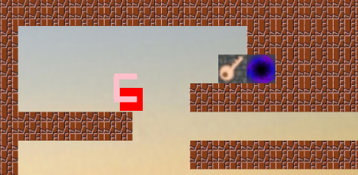
(3) Portal
New World !
* You cannot be back to the previous world, so collect all things you can collect !

Slide 13
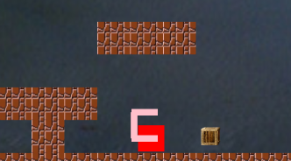
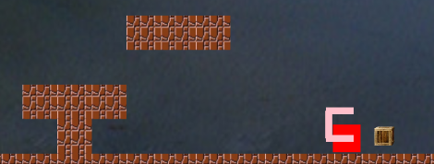
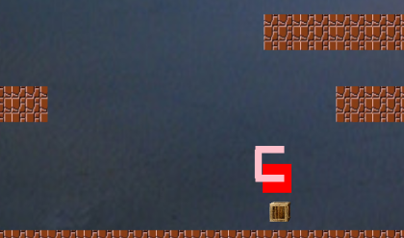
(4) Moving boxes
Push !
Then, you can jump onto the box to reach the high step !

Slide 14
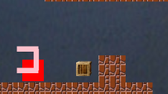
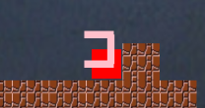
Strategy !
If meeting annoying boxes, push them to the walls, then they would disappear. Surprise!
Push !

Slide 15
Wow Factors
Multiple Levels & Multiple Worlds
Save & Load

Slide 16
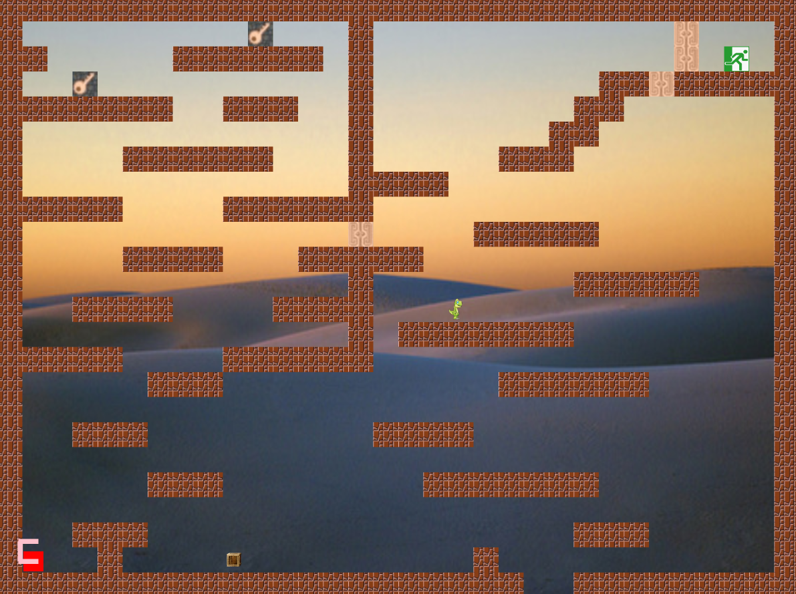
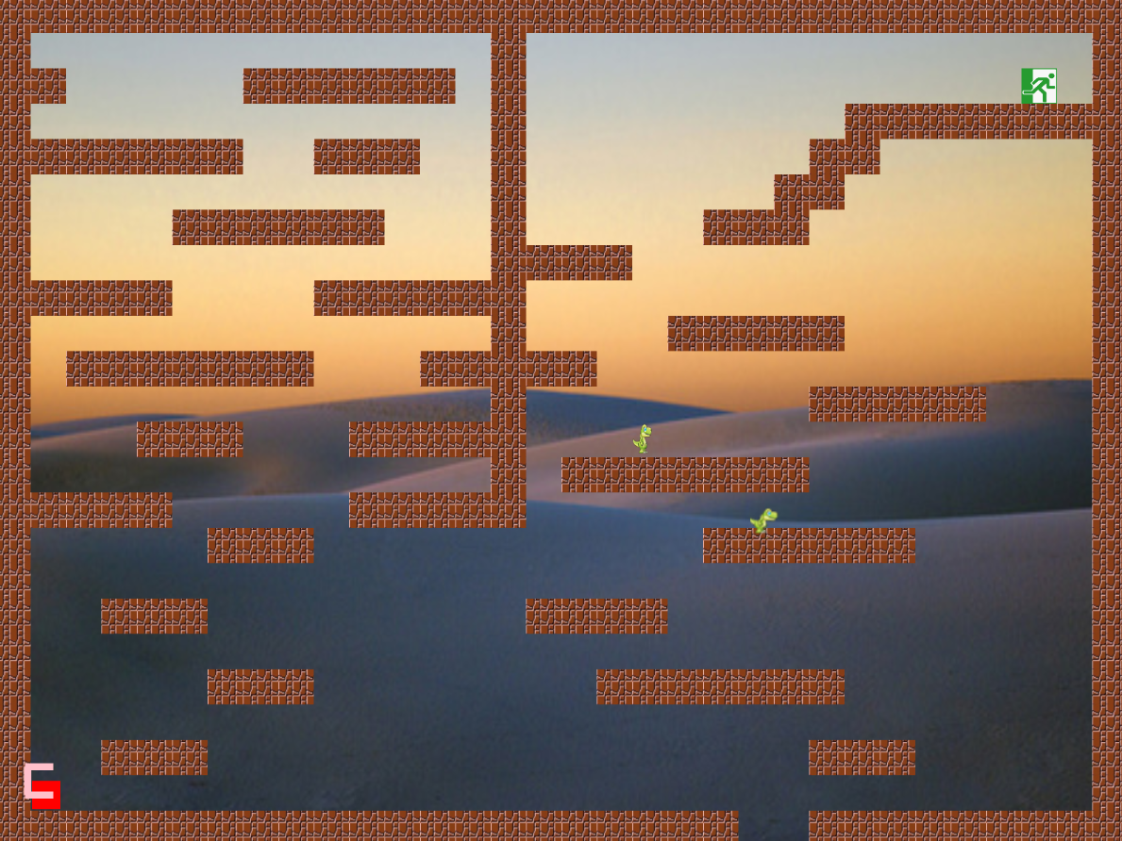
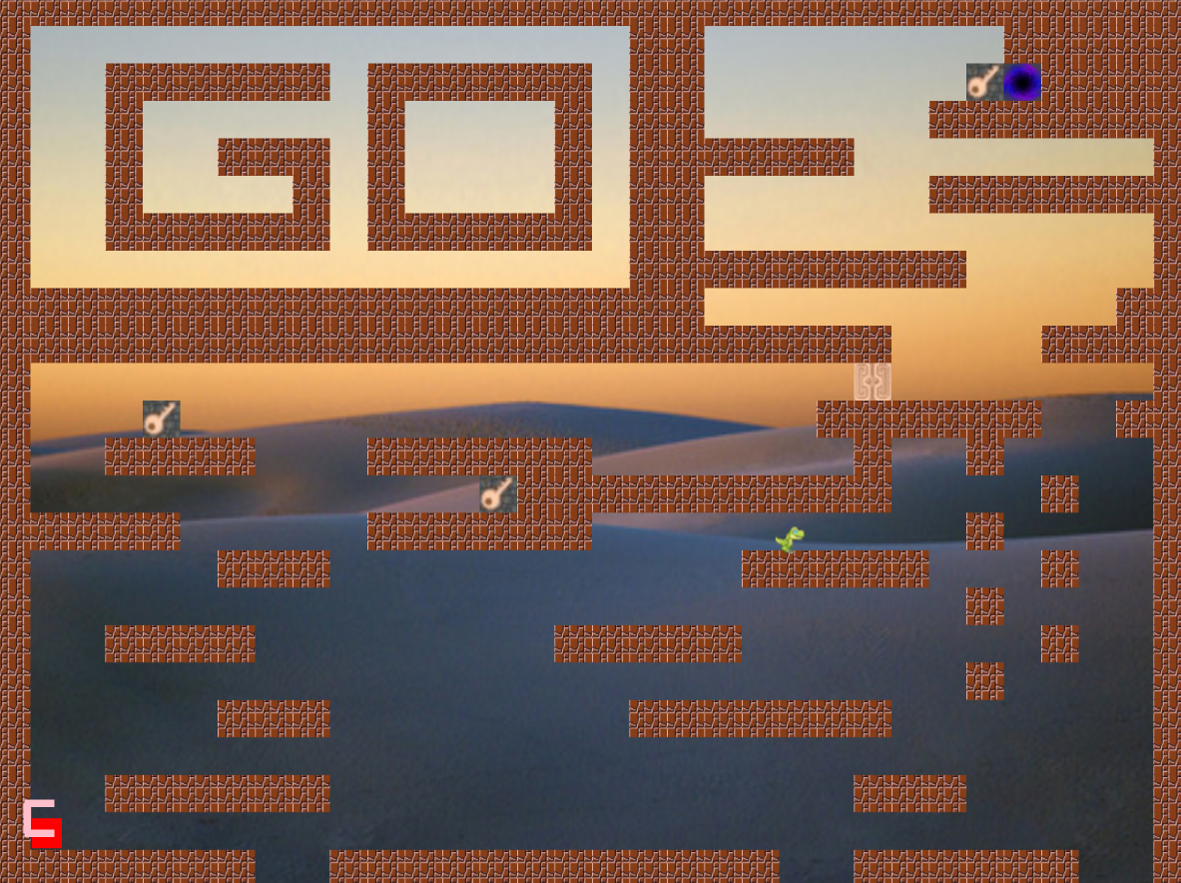
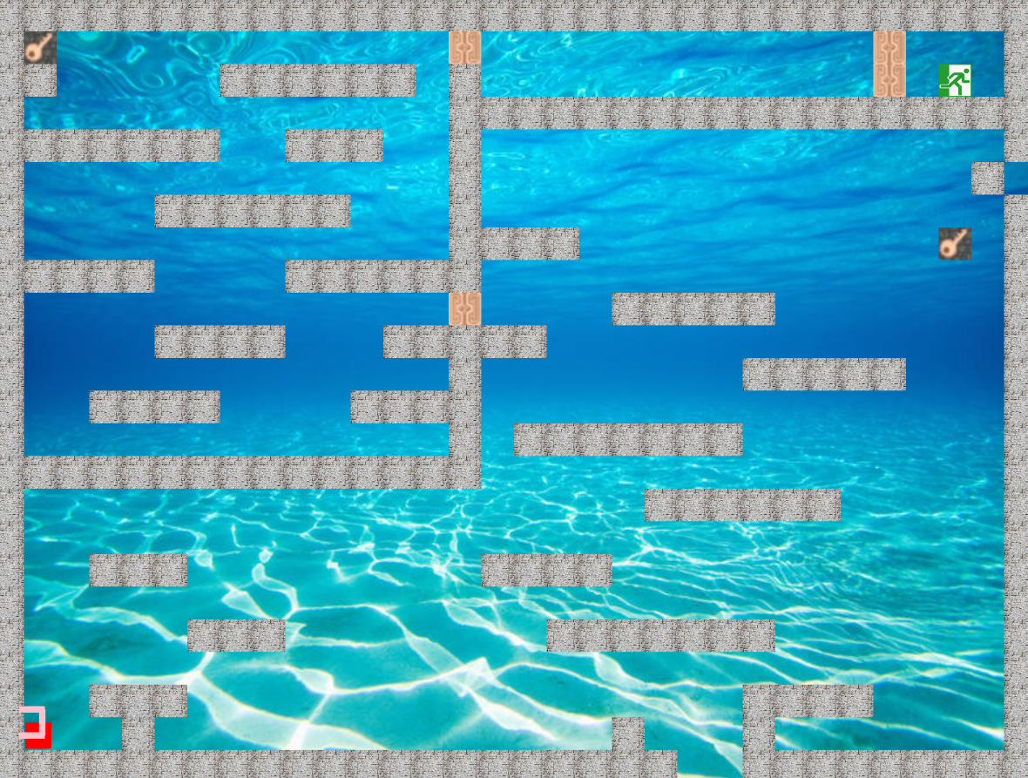
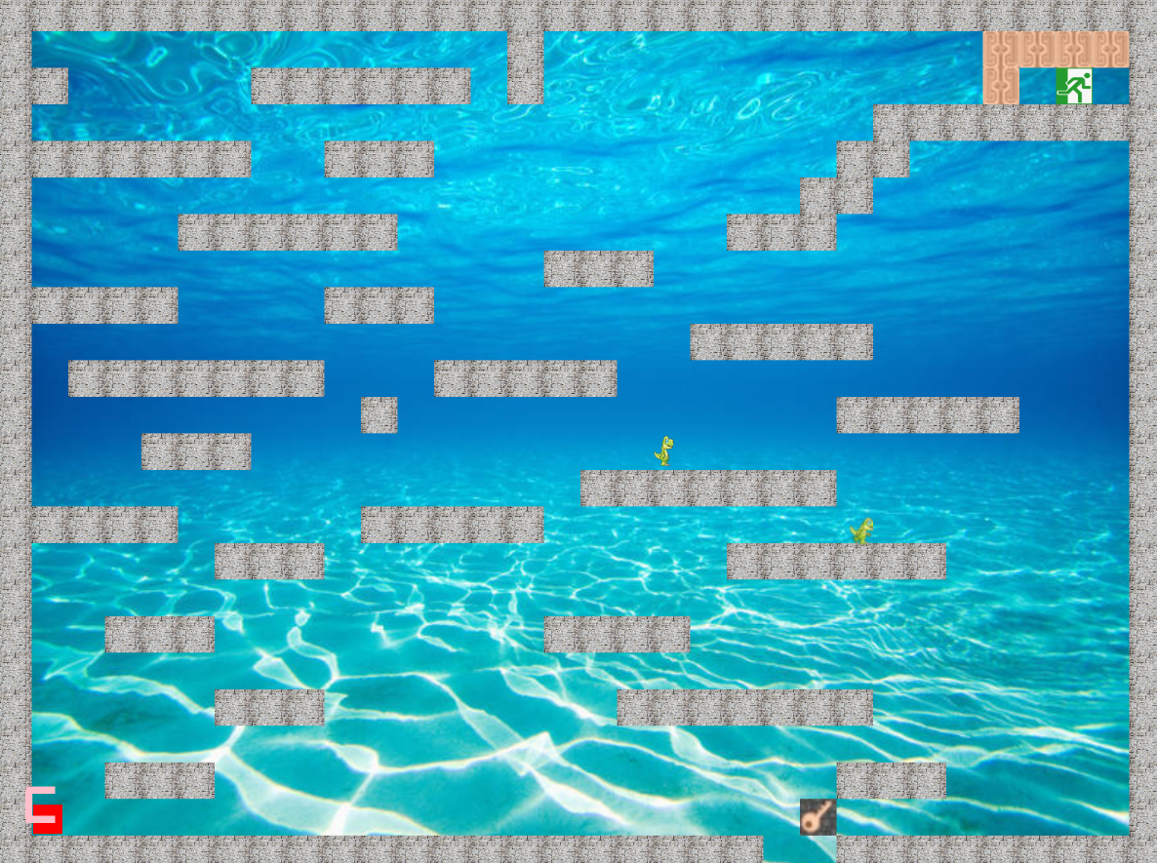
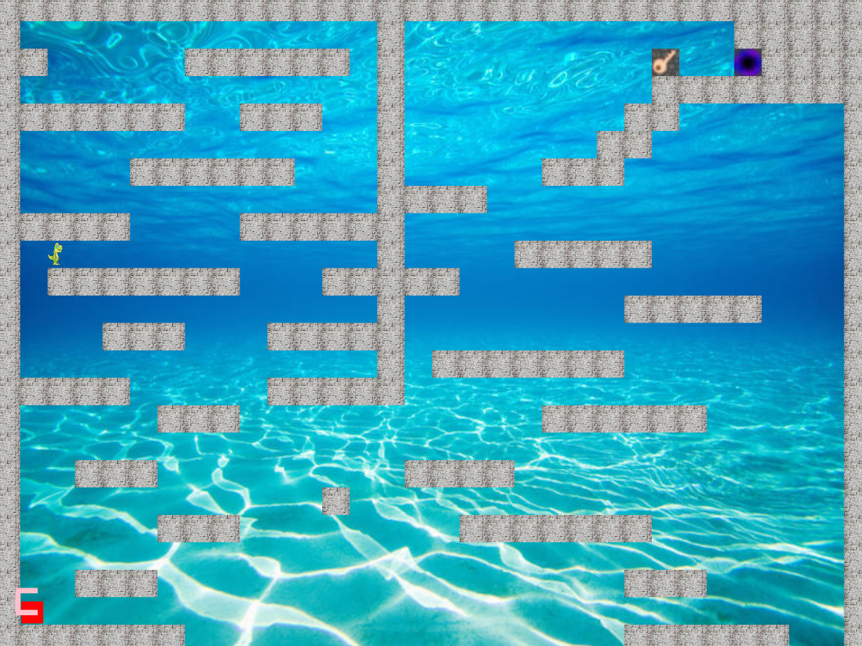
(1) Multiple Levels & Multiple Worlds

Slide 17
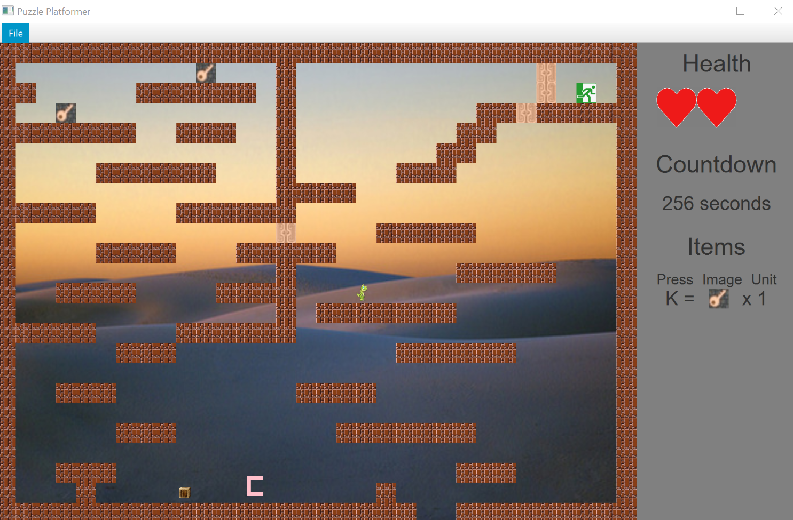
(2) Save & Load
Click “File” => Click “Save Game”
Pay attention to Health,
Countdown,
Player’s position.

Slide 18
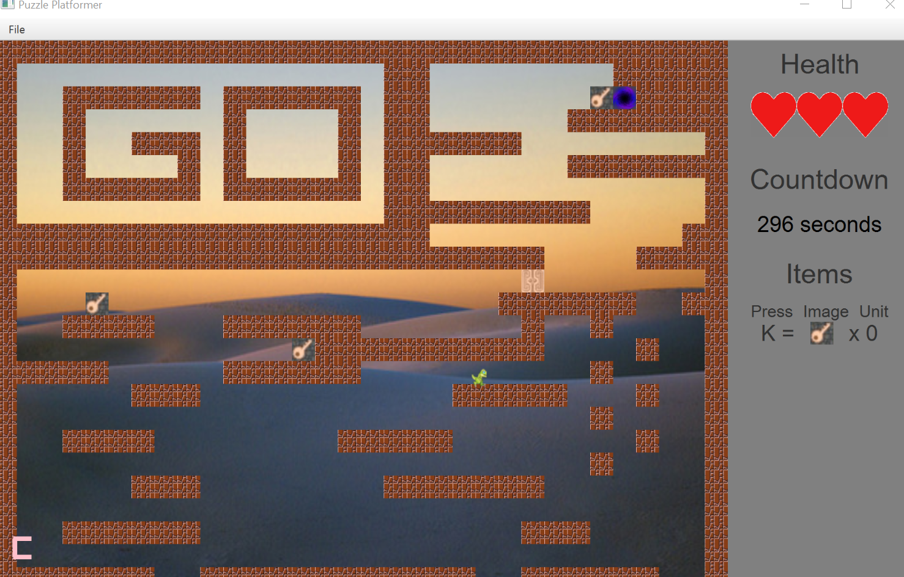
Switch To Another Map
Then, test “Load Game”

Slide 19
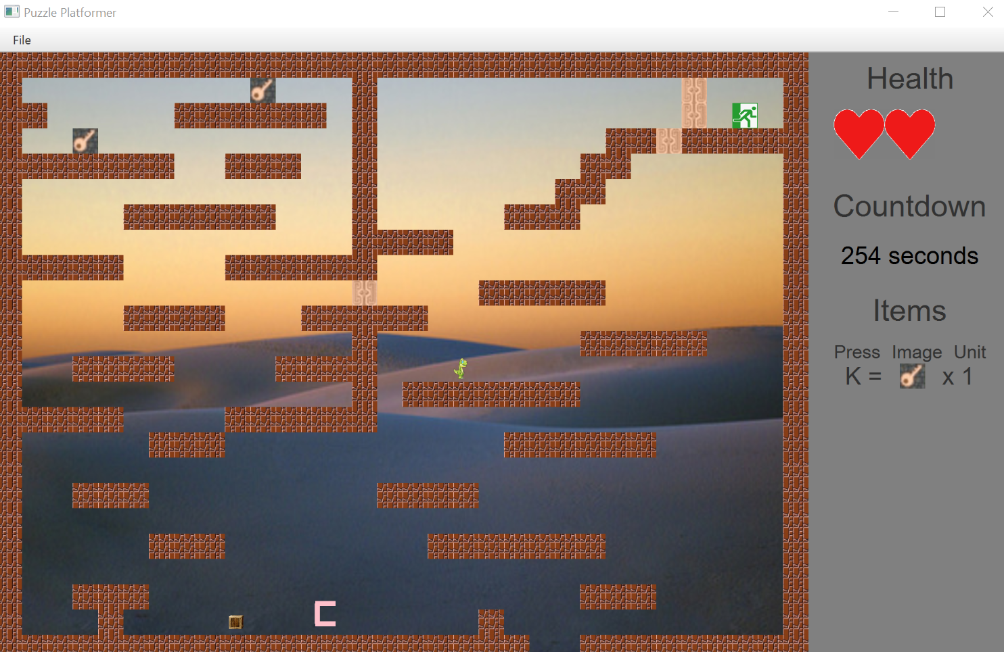
Click “File”
=> Click “Load Game”
Check Health,
Countdown,
Player’s position.
Great! We succeeded!
* The file location is “c://Users//Public//puzzle_platformer.dat”

Slide 20
Thanks For Watching
Group member
Eujin Ko, Lize Chen,
Perry Wang, Suyang Chen

